Slide 1



DEPI_1_BNS1_DAT1_G1d
Adventure Works
Project
Graduation

Slide 2



MEMBER OF GROUP
Anfal
Mahmoud
Mohamed Ahmed
Esraa
Ibrahim

Slide 3

Agenda:
Introduction
AdventureWorks Dataset Overview
Data Exploration with SQL
Data Cleaning
Production Schema Focus
Data Analysis & Insights
Dashboard Overview
Recommendations
Conclusion
Q&A

Slide 4
1. Intorduction:
The key objectives: were to analyze production performance, identify potential inefficiencies, understand order processing, and track product purchasing. The aim was to develop actionable insights to enhance production planning and operational efficiency.
Tools Used: The primary tools used were SQL for extracting and manipulating data, and Power BI for visualizing results and building the final dashboard.
Overview of Key Findings: Some of the key findings that will be covered include delays in production, inefficiencies in component usage, and potential areas for improving work order processing .

Slide 5
2. AdventureWorks Dataset Overview:
AdventureWorks is a comprehensive database designed for a fictional company that manufactures and sells bicycles and other related products. The dataset contains various schemas, each representing different aspects of the business, such as sales, production, and purchasing. In this project, the focus was on the Production of Product and purchasing Schemas, which holds critical information about product manufacturing, including components, shipping, work orders, and routing sequences.

Slide 6

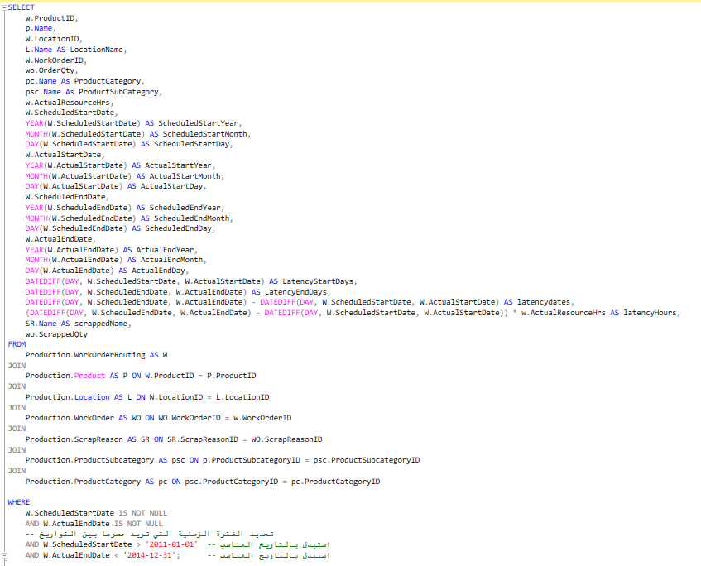
This query is designed to extract and analyze data from the production workflow, specifically focusing on work orders within a defined time frame. It pulls key details such as Product Name, Location, Order Quantity, and Resource Hours to gain insights into the production timeline. By comparing scheduled start and end dates with actual start and end dates, the query highlights delays in production processes, represented by Latency Days and Latency Hours.
3. 1. Data Exploration with SQL:
Purpose of this query: To evaluate how efficient the production was by identifying discrepancies between scheduled and actual timelines. It also includes scrap information to monitor how much product was discarded due to production issues. This analysis helps identify bottlenecks in the process, inefficiencies, and possible causes of delays, providing valuable insights for optimizing production workflows.

Slide 7

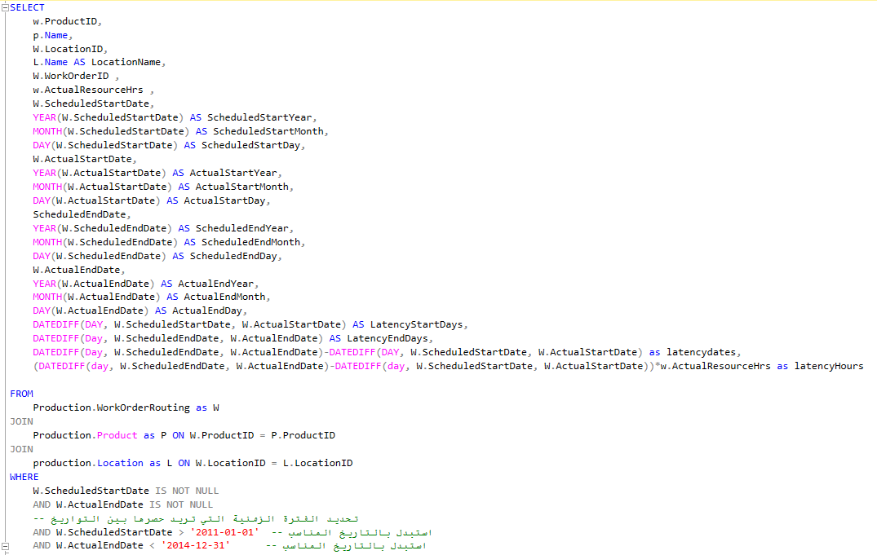
This query is aimed at assessing the efficiency of the production process by analyzing the differences between scheduled and actual timelines for work orders. It retrieves details about products, locations, and work orders, and focuses on the actual resource hours used during production. By calculating the latency in both the start and end dates, the query identifies delays in the process.
3. 2. Data Exploration with SQL:
Purpose of this query : To track production delays and calculate their impact in terms of both time and resources. The latency days are calculated as the difference between scheduled and actual start and end dates. The latency hours metric multiplies the delay by the number of resource hours involved, giving a more comprehensive picture of the overall delay in production.

Slide 8
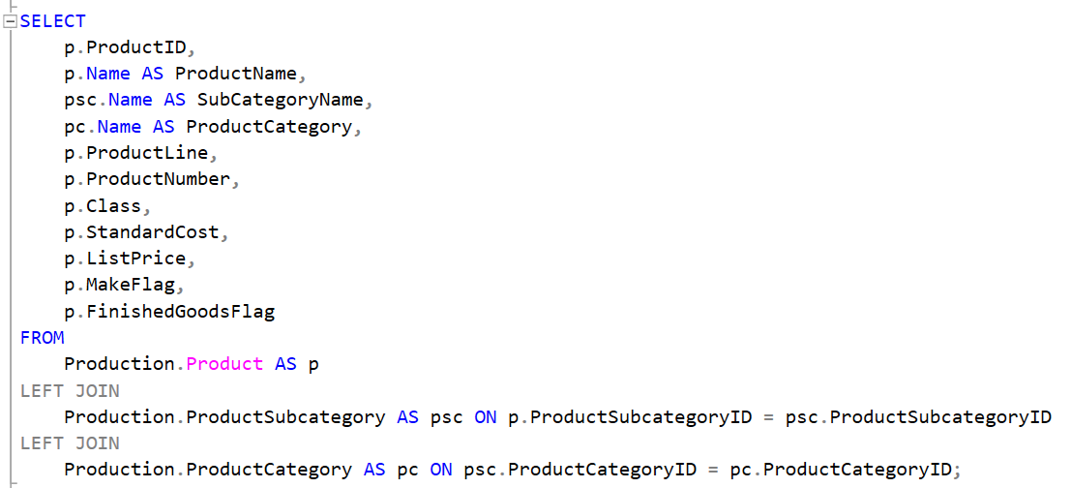
This query is used to extract detailed information about products in the AdventureWorks database, including their categories, subcategories, and pricing details. The focus is on gaining an understanding of the product catalog, which can be useful for various types of analysis, such as inventory management, sales trends, and product performance.
3. 3. Data Exploration with SQL:
This query is valuable for generating insights into the product structure within the company and understanding how different product categories and subcategories are related. It helps management teams to:
Organize products by categories for better inventory tracking.
Monitor product pricing strategies.
Analyze the ratio of finished goods versus in-progress goods.

Slide 9
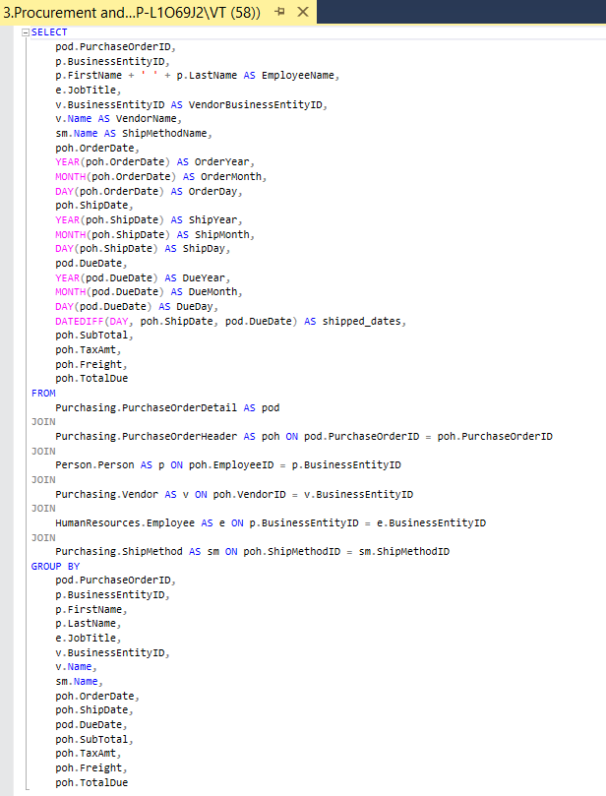
This SQL query retrieves comprehensive information regarding products from the database. The main objective is to extract details about each product, including its category and subcategory, which can aid in product analysis and inventory management.
3. 4. Data Exploration with SQL:
The primary goal of this query is to provide a structured overview of products, categorizing them into subcategories and categories. This information is crucial for various analyses, such as inventory management, sales performance evaluation, and strategic planning. By understanding the relationships and classifications of products, businesses can make informed decisions regarding stock levels, marketing strategies, and product development.

Slide 10
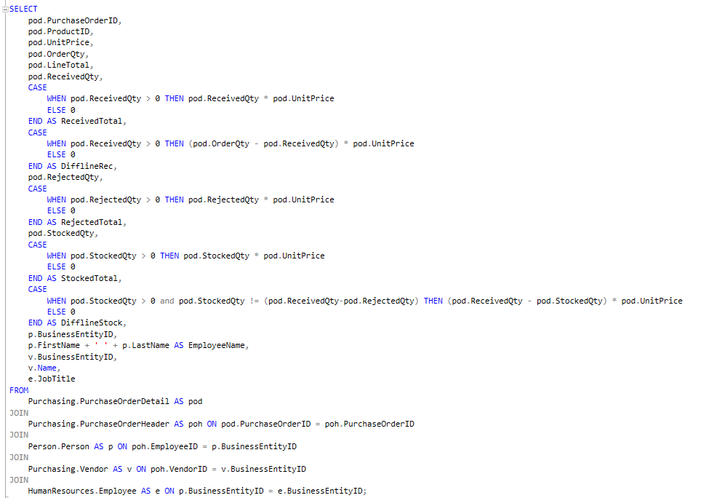
3. 5. Data Exploration with SQL:
The main goal of this query is to provide a detailed breakdown of each purchase order, focusing on the quantities of items received, rejected, and stocked, along with their corresponding financial values. This information is valuable for inventory management, financial analysis, and understanding the efficiency of the purchasing process.
By assessing the quantities and statuses of ordered products, businesses can identify potential issues in the supply chain, make informed decisions on stock management, and evaluate vendor performance. This data ultimately aids in optimizing procurement strategies and improving overall operational efficiency.

Slide 11
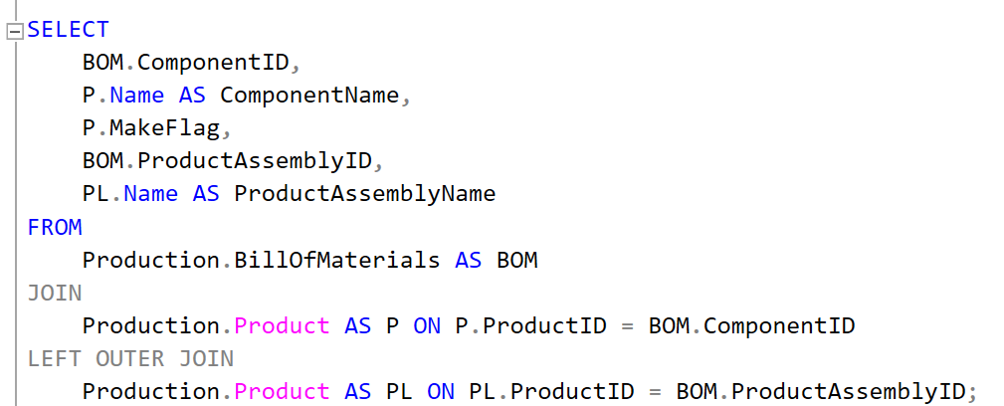
3. 6. Data Exploration with SQL:
The goal of this query is to provide a breakdown of the components used in product assemblies, including their names and whether they are made in-house or outsourced.
The query also links each component to its corresponding product assembly (if applicable). This information is valuable for understanding the composition of products, analyzing the supply chain, and managing inventory.
By identifying both components and assemblies, the company can make informed decisions about production, sourcing, and cost management.

Slide 12
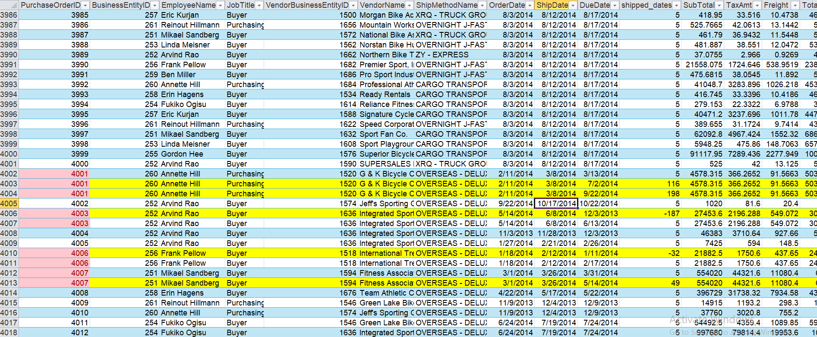
3. 7. Data Exploration with Excel:
The yellow-highlighted lines removed from the shipping query represent raw data. These lines contained direct data values that were irregular and duplicates, which were not needed for the final analysis, so they were excluded from the documentation to maintain accuracy and consistency.

Slide 13
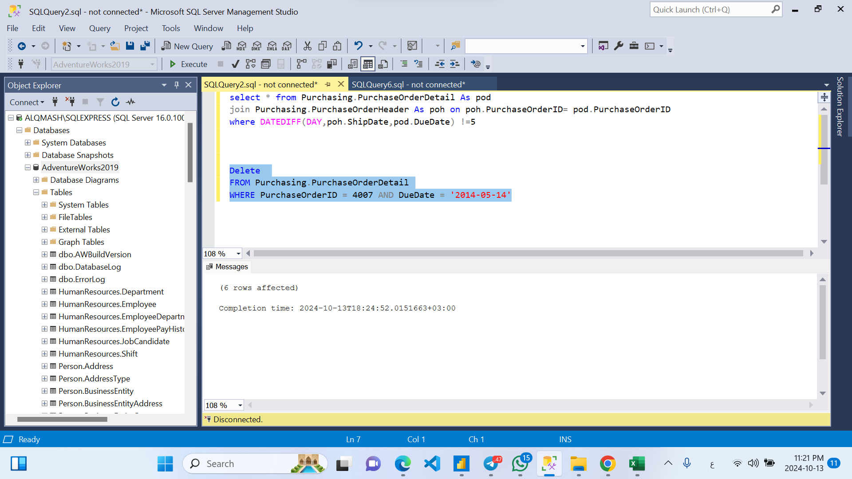
4. Data cleaning by SQL:
Removing The goal here is to ensure that data maintains accuracy and consistency. By removing entries that don't align with expected shipping time, It useful to improving the reliability of dataset for further analysis. that don't align with expected shipping time.

Slide 14

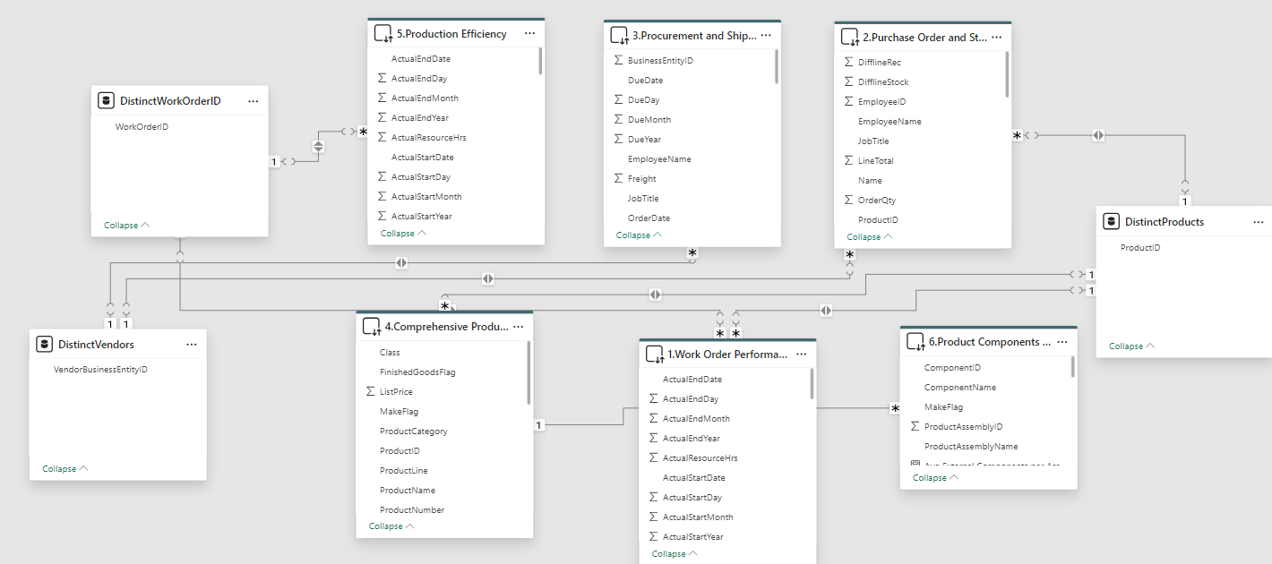
5. PROJECT Production , Purchasing Schema Focus:
This schema, built using Power BI, showcases the relationships between various tables essential for analyzing production efficiency in the AdventureWorks dataset. Key tables include Work Order Performance, Product Components, and Procurement and Shipping, all connected to analyze production timelines, component usage, and procurement efficiency. The relationships were designed to track the entire workflow, from procurement to production and stock management, ensuring comprehensive insights into the production process.

Slide 15
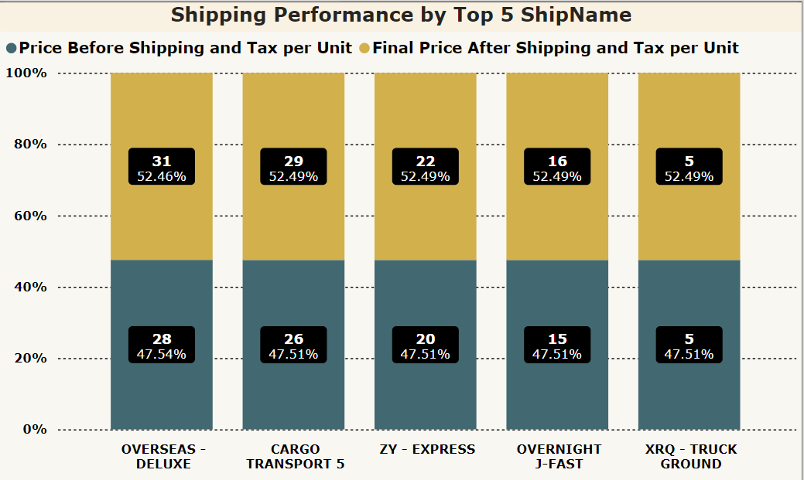
6.1. Data Analysis & Insights:
Q1: How does shipping performance vary by carrier?
Answer: The chart shows that different shipping companies have varied performances in terms of the percentage of total costs before and after shipping and tax. "OVERSEAS-DELUXE" and "CARGO TRANSPORT 5" account for 47.3% of the cost before and after shipping and tax.
Investigate the reasons behind the cost variations for each shipping provider and identify opportunities to streamline shipping for cost savings.

Slide 16
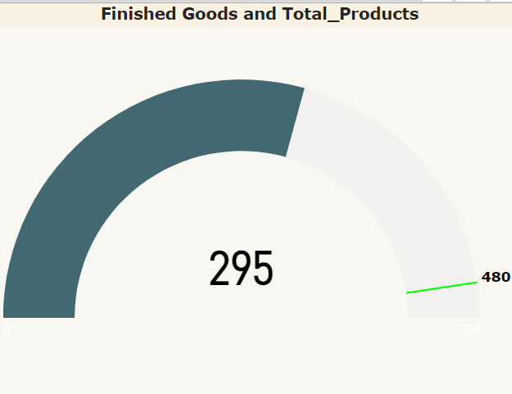
6.2. Data Analysis & Insights:
Q2: How many finished goods are there?
Answer: There are 295 finished goods compared to a total of 480 products.
Investigate the gap between finished goods and total products to identify any delays or bottlenecks in the final stages of production.

Slide 17
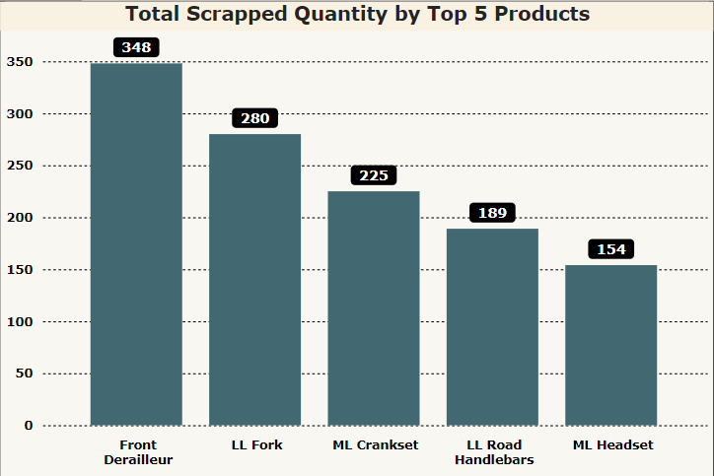
6.3. Data Analysis & Insights:
Q3: Which products have the highest scrapped quantities?
Answer: The "Front Derailleur" and "LL Fork" products have the highest scrapped quantities, with 348 and 280 units, respectively.
Conduct a root cause analysis on the top scrapped products to improve product quality and reduce waste.

Slide 18
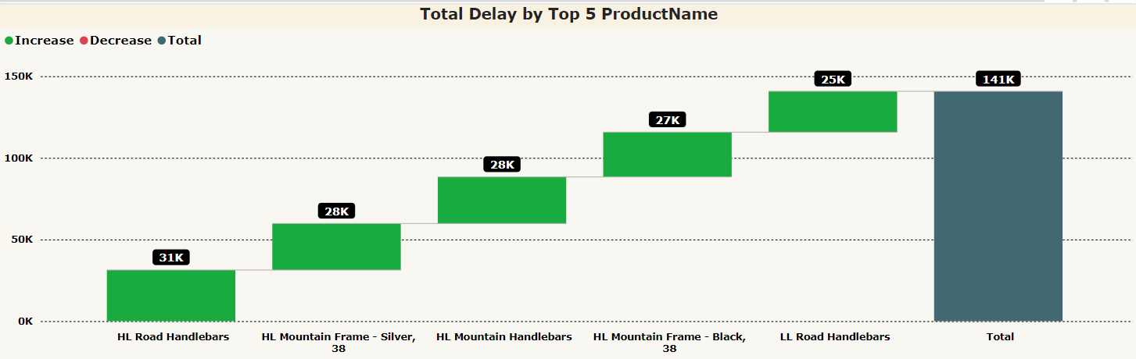
6.4. Data Analysis & Insights:
Q4: Which products contribute the most to shipping delays?
Answer: "LL Road Handlebars" contribute the most to shipping delays with a total of 141K units delayed.
Focus on improving the supply chain for this product, as reducing delays could significantly enhance overall delivery performance.

Slide 19
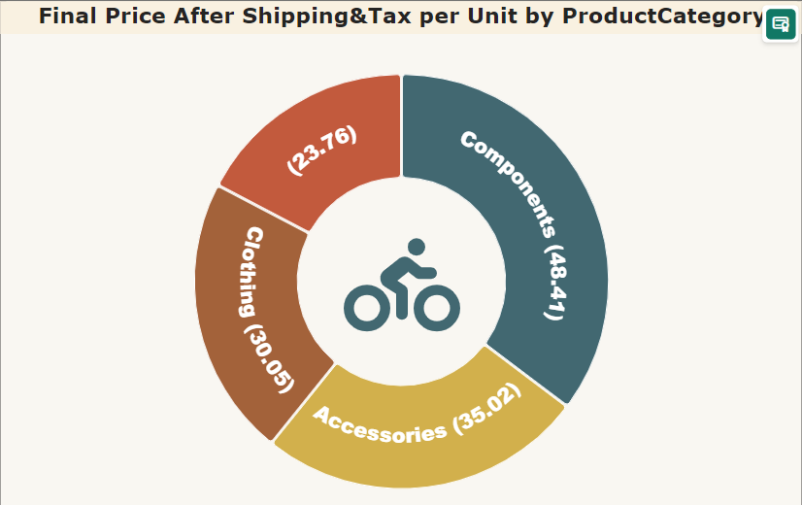
6.5. Data Analysis & Insights:
Q5: What is the final price per unit across product categories after shipping and tax?
Answer: The final price distribution shows significant costs across "Bicycles," "Components," and "Accessories," with a majority attributed to "Bicycles."
Review pricing strategies for product categories to ensure competitive pricing after factoring in shipping and taxes, especially for higher-cost items like bicycles.

Slide 20
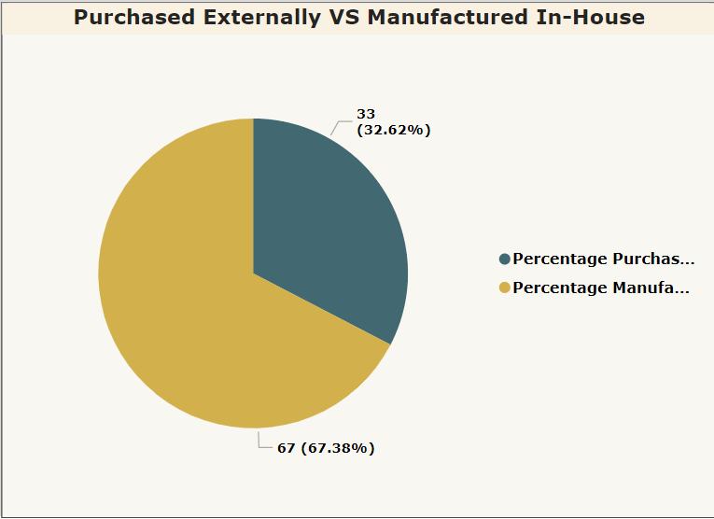
6.6. Data Analysis & Insights:
Q6: How is production divided between in-house manufacturing and external purchasing?
Answer: Approximately 67% of products are purchased externally, while 33% are manufactured in-house.
Assess whether increasing in-house production could reduce costs and improve quality control.

Slide 21
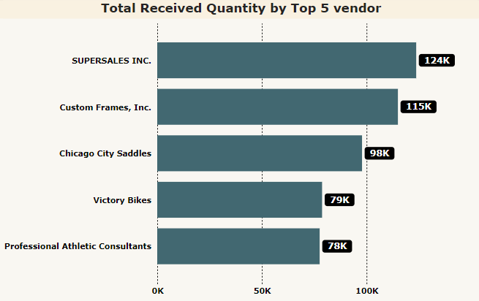
6.7. Data Analysis & Insights:
Q7: Which vendors supply the highest quantities?
Answer: "SUPERSALES INC." supplies the most, with 124K units received, followed by "Custom Frames, Inc." with 115K units.
Monitor the performance of these top vendors to ensure they continue to meet quantity and quality standards.

Slide 22
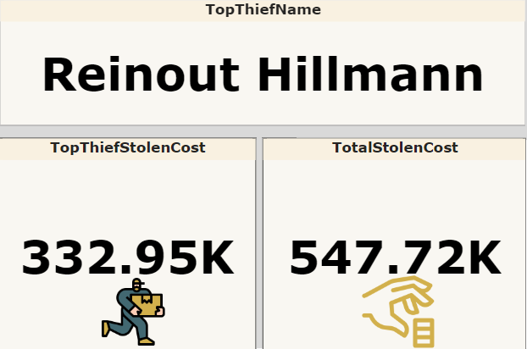
6.8. Data Analysis & Insights:
Q8: Who is responsible for the highest theft, and what is the total stolen cost?
Answer: "Reinout Hillmann" is the top thief, with a stolen cost of 332.95K, contributing to a total stolen cost of 547.72K.
Implement stronger theft prevention strategies to minimize losses, focusing on areas with the highest theft incidents.

Slide 23
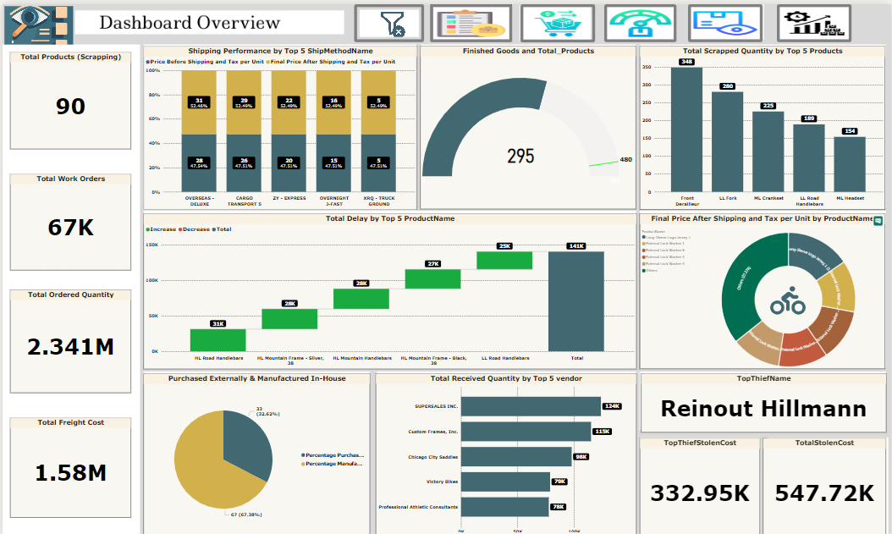
7. 1. Dashboard Overview:
In this dashboard, we are visualizing KPIs and insights related to production, procurement, shipping, and work order management. Here's a concise explanation of the dashboard and its main insights:

Slide 24
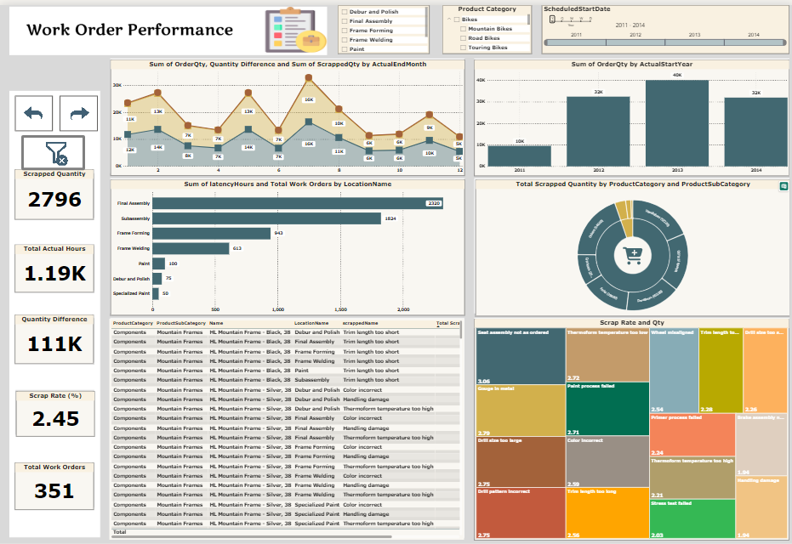
7.2.Work Order Performance:
This dashboard focuses on Work Order Performance, showcasing critical metrics related to production efficiency, scrap rates, order quantities, and time management in various manufacturing processes.

Slide 25
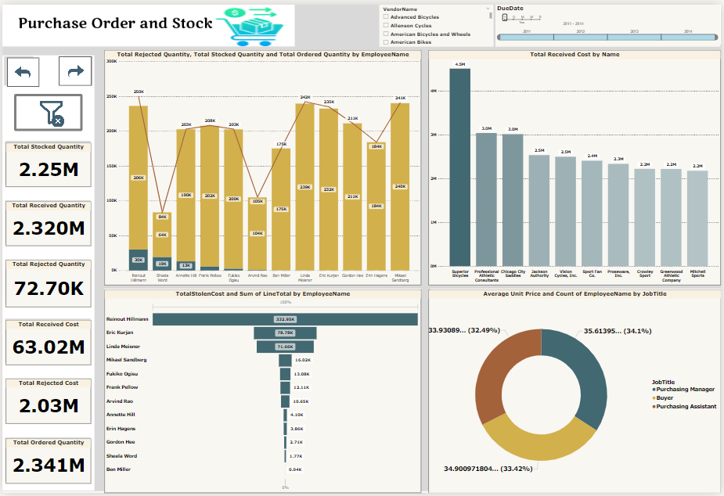
7.3.Purchase Order and Stock:
This dashboard is designed to provide a holistic view of the purchase order and inventory process, allowing for detailed analysis of cost, quantity, and employee performance in inventory and stock management.

Slide 26
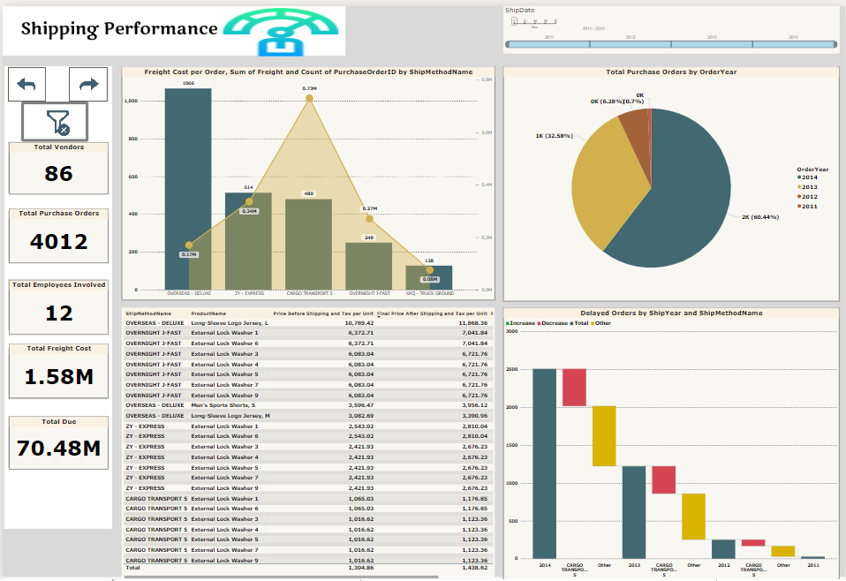
7.4. Procurement and Shipping Performance:
This dashboard offers an overview of shipping performance, highlighting costs, carrier efficiency, and delivery trends over time to support strategic decisions.

Slide 27
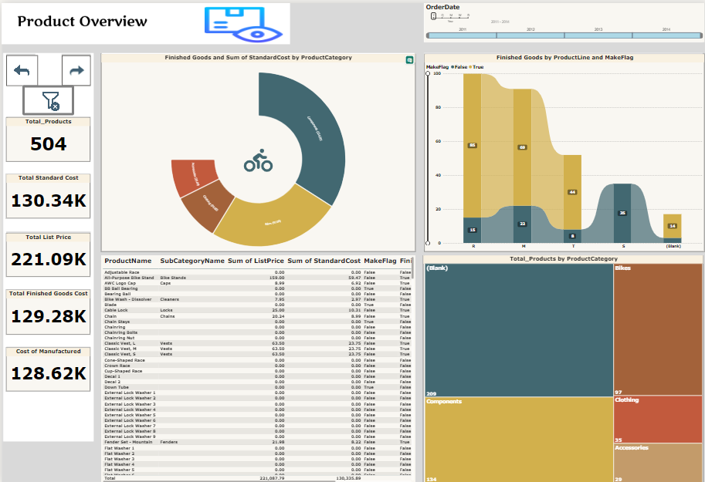
7.5. Product Overview:
This dashboard provides an overview of product metrics, including the total number of products, costs, and distribution across categories, aiding in the analysis of product manufacturing and inventory management.

Slide 28
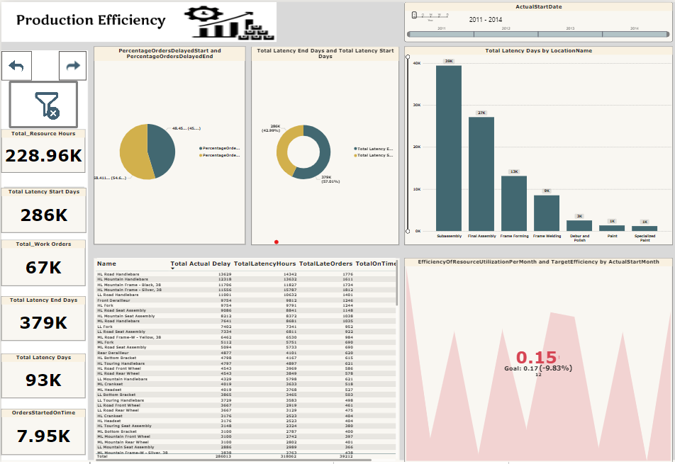
7.6. Production Efficiency:
This dashboard provides a comprehensive analysis of production performance, highlighting key metrics and visualizations that offer insights into resource utilization, start and end delays, and overall operational efficiency.

Slide 29
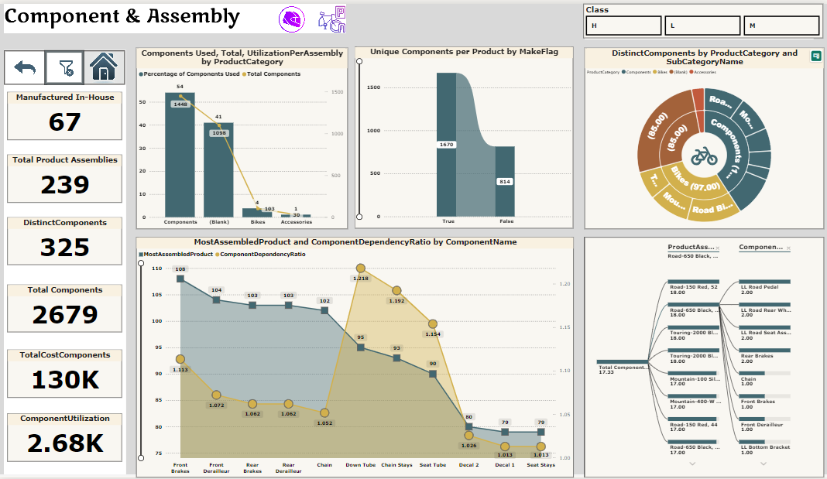
7.7.Product Components and Assembly:
This dashboard offers a detailed analysis of component and assembly data, highlighting key metrics such as total product assemblies, component utilization, and manufacturing distribution.

Slide 30
8. Recommendations:
Reduce Waste: Focus on products with high scrapping rates and investigate root causes.
Optimize Shipping Costs: Consider revising contracts with "OVERSEAS - DELUXE" or finding alternatives to cut shipping costs.
Tackle Delays: Prioritize reducing delays in high-impact products like "HL Road Handlebars" through process improvement or better scheduling.
Improve Security: Address theft by enforcing stricter controls and monitoring over the employees responsible for inventory.

Slide 31
9. Conclusion:
Summary of Key Findings: The analysis identified significant inefficiencies in production, including delays and discrepancies in stock management. Addressing these issues can help the company reduce costs and improve production efficiency.
Importance of the Analysis: This analysis provides actionable insights that can help the company streamline its production processes, reduce losses due to theft, and enhance overall efficiency.
Next Steps: Based on these findings, the company can take steps to improve both production and inventory management, which will ultimately lead to better operational outcomes. Future analyses could focus on optimizing specific production stages or further investigating purchasing discrepancies.

Slide 32

10. Q&A:

Slide 33

THANK YOU!

